Slide 1
Assemblies in C#
Sarita Lad
DATE

Slide 2
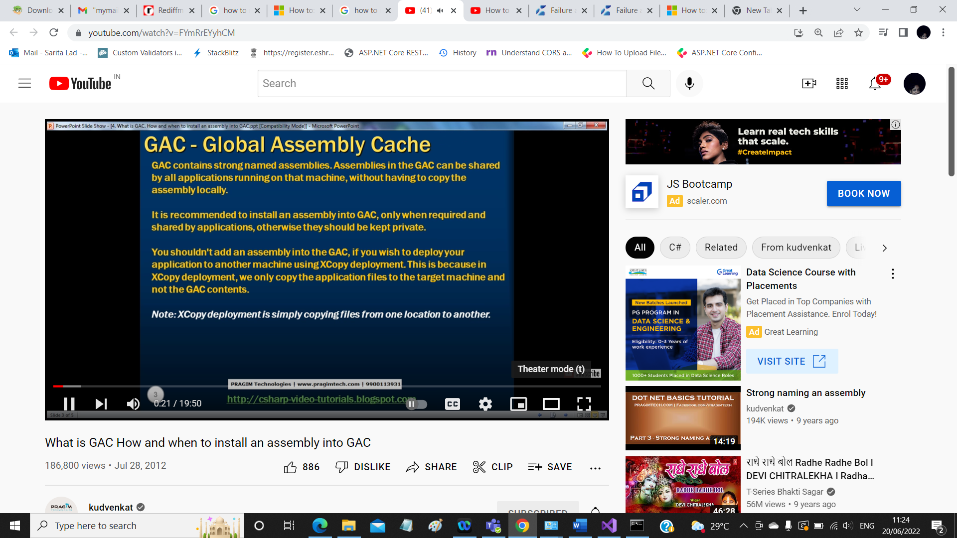
Shared Assemblies:

Slide 3
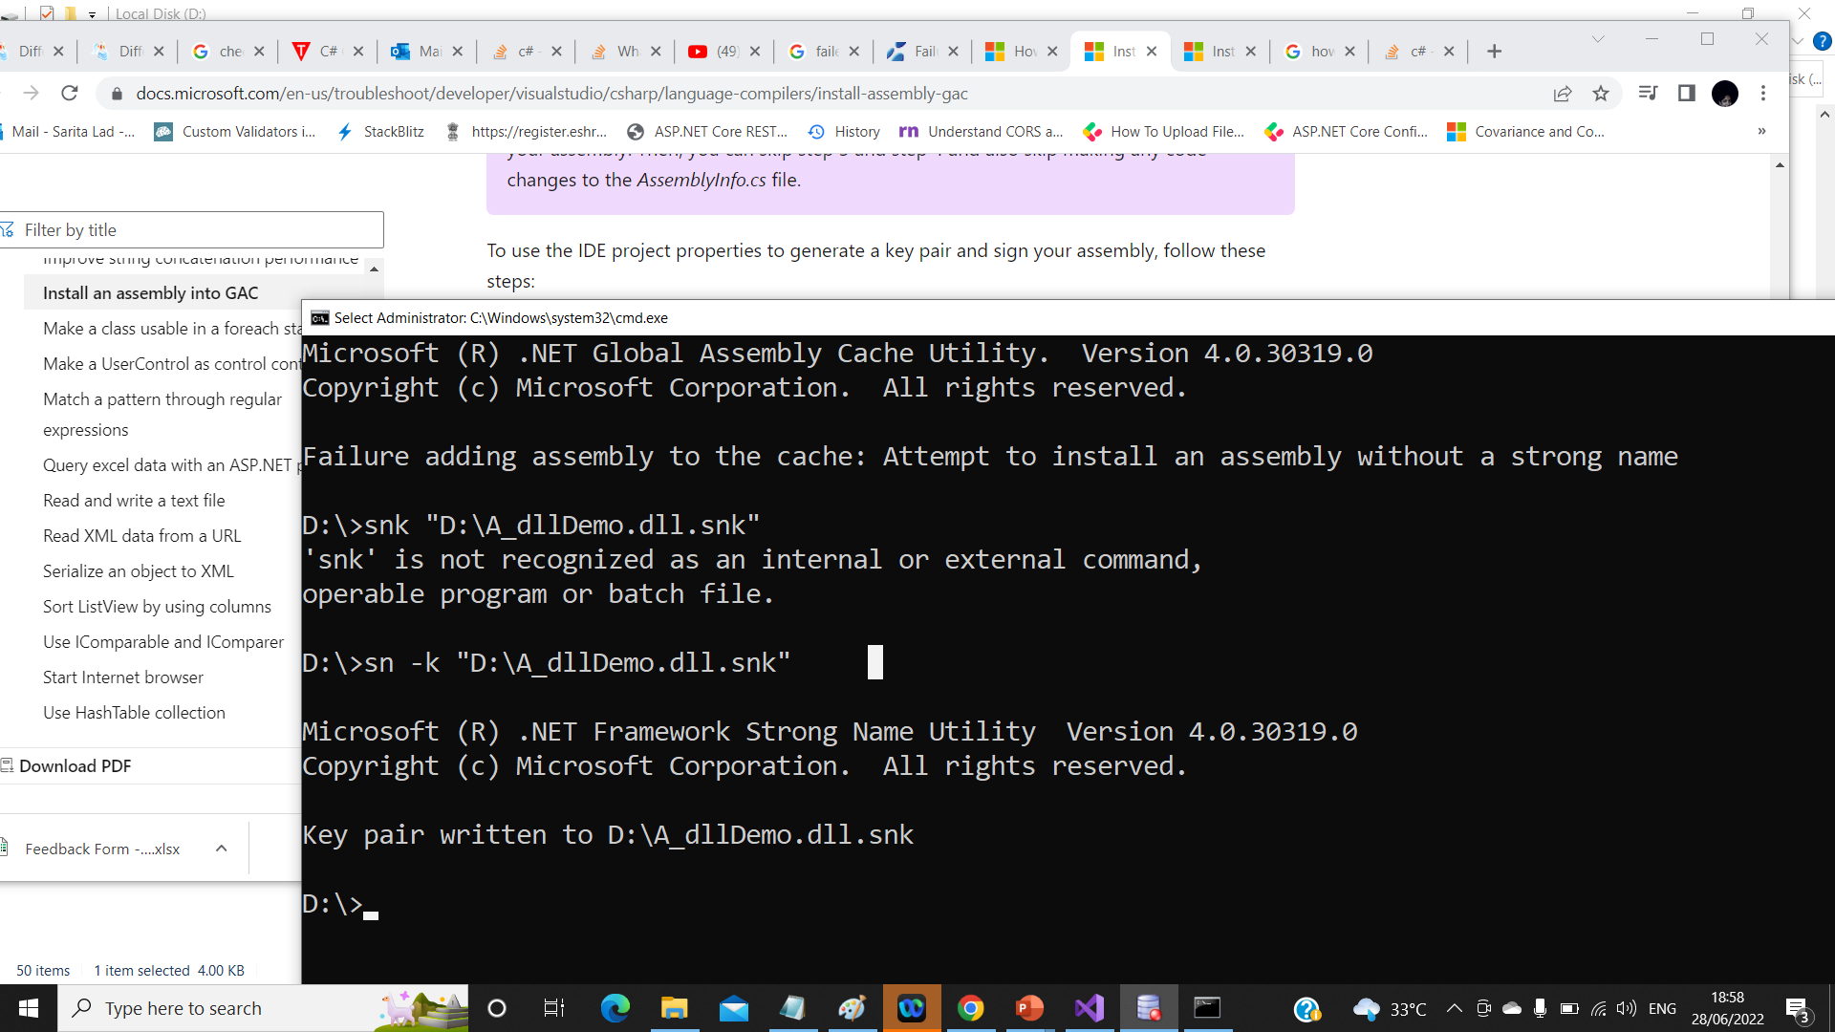

Slide 4
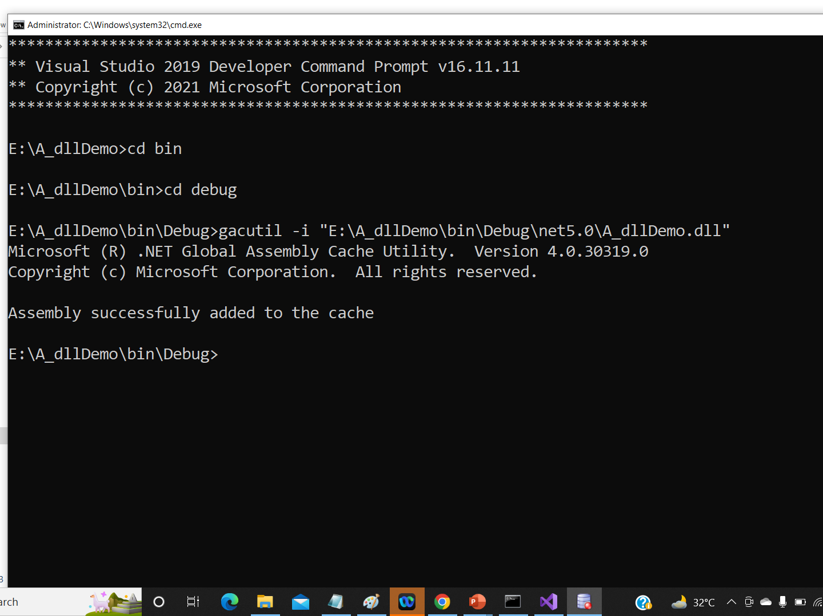

Slide 5
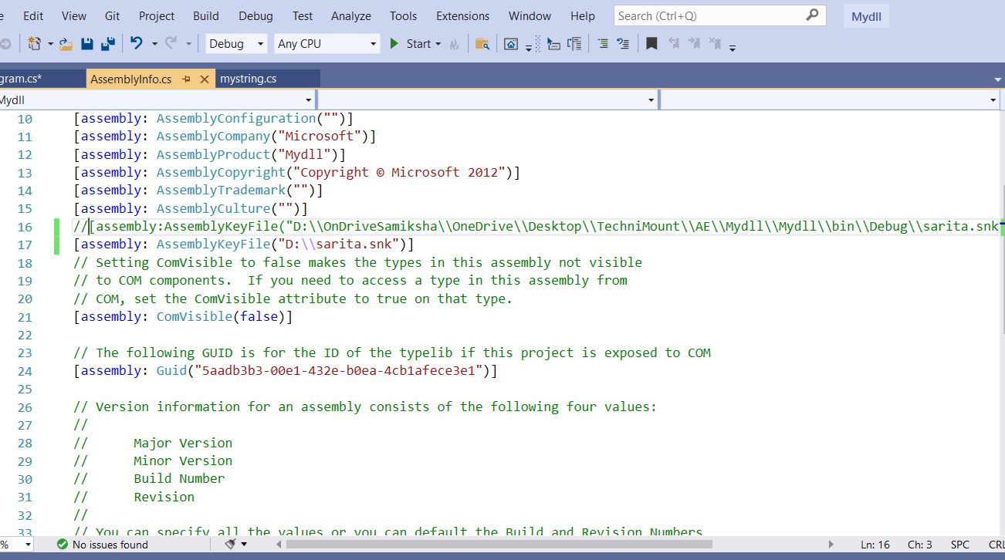
Open visual studion as administrator:
sn -k "D:\sarita.snk
Drive path \>gacutil -i mydll.dll

Slide 6
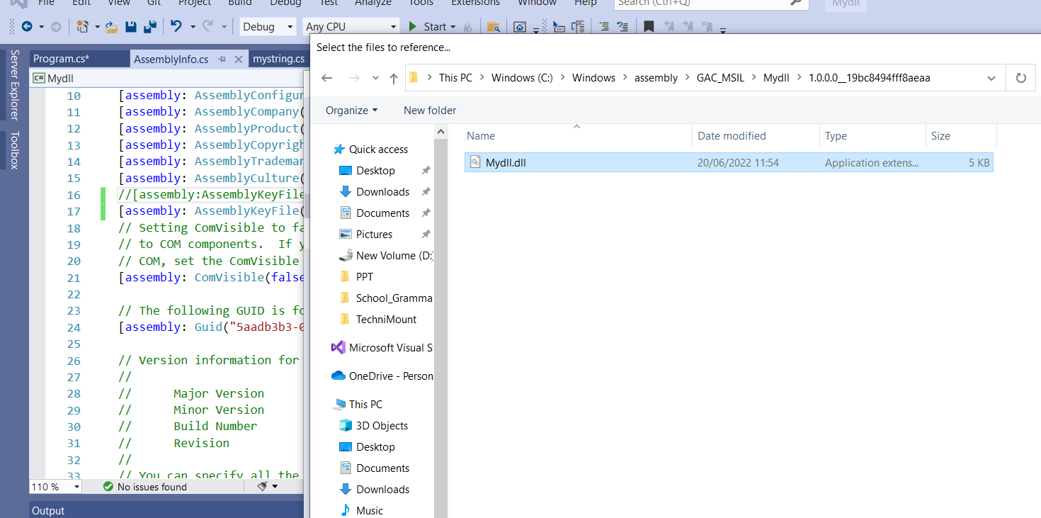

Slide 7
Thank You

